Slide 1

Analysis on the Legalization of Recreational Marijuana in the State of Colorado
UCI Data Analytics Bootcamp
Team 5
Josh, Peter, Sai, Stefanie
September 17, 2018

Slide 2
Does legal marijuana effect housing values?
Data Analysis Methodology
Housing values were downloaded from zillow.com. The “Housing Valuation Index (HVI)” was studied.
A list of marijuana stores was downloaded from colorado.gov. The primary data point used in this study was the physical location of the store (street, city and zip code).

Slide 3
CO Housing Price Trends 2012 - 2018
Coding logic
Step 1: Load Zillow housing data from csv into a dataframe
Step 2: Load marijuana stores data from csv into a dataframe
Step 3: Summarize data by decade and group by city
Step 4: Create 2 dataframes – one for cities with no MJ stores and one for cities with MJ stores
Step 5: Build a line graph that depicts overall housing price trends from 2012 – 2018 for the whole state, MJ cities and “dry” cities

Slide 4
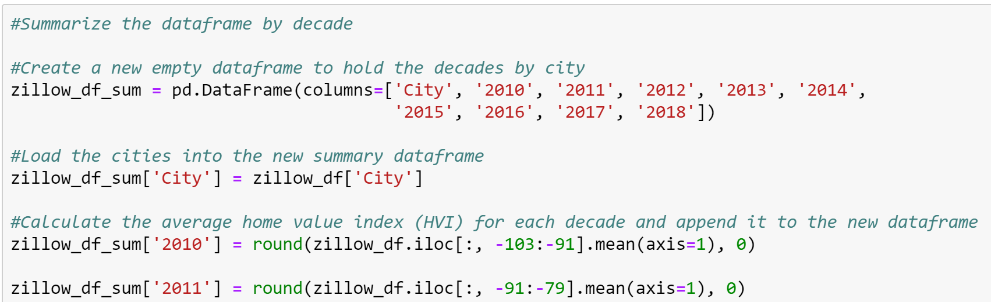
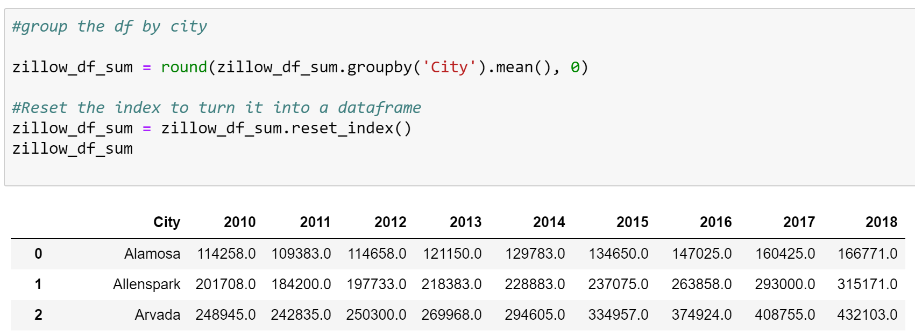
Code Snippets

Slide 5
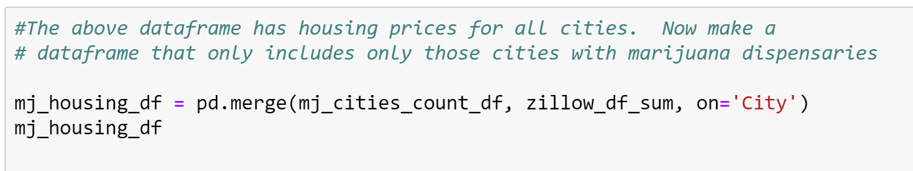
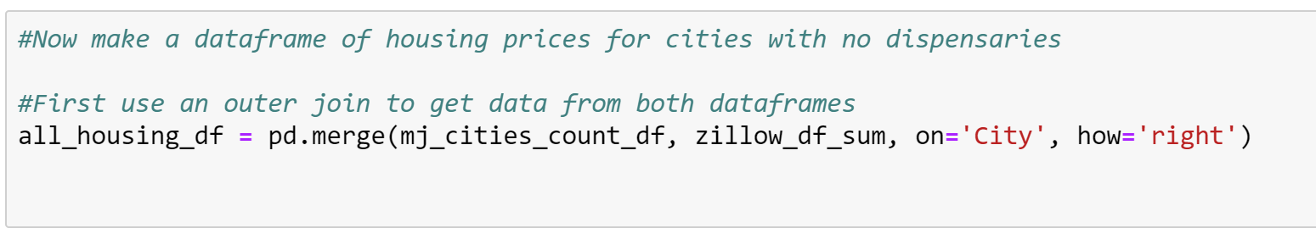
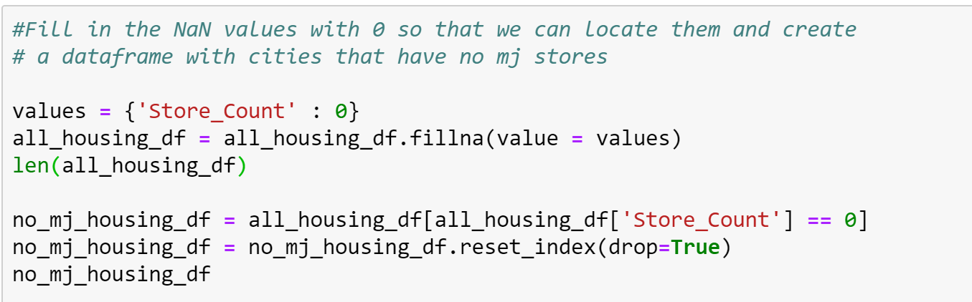

Slide 6
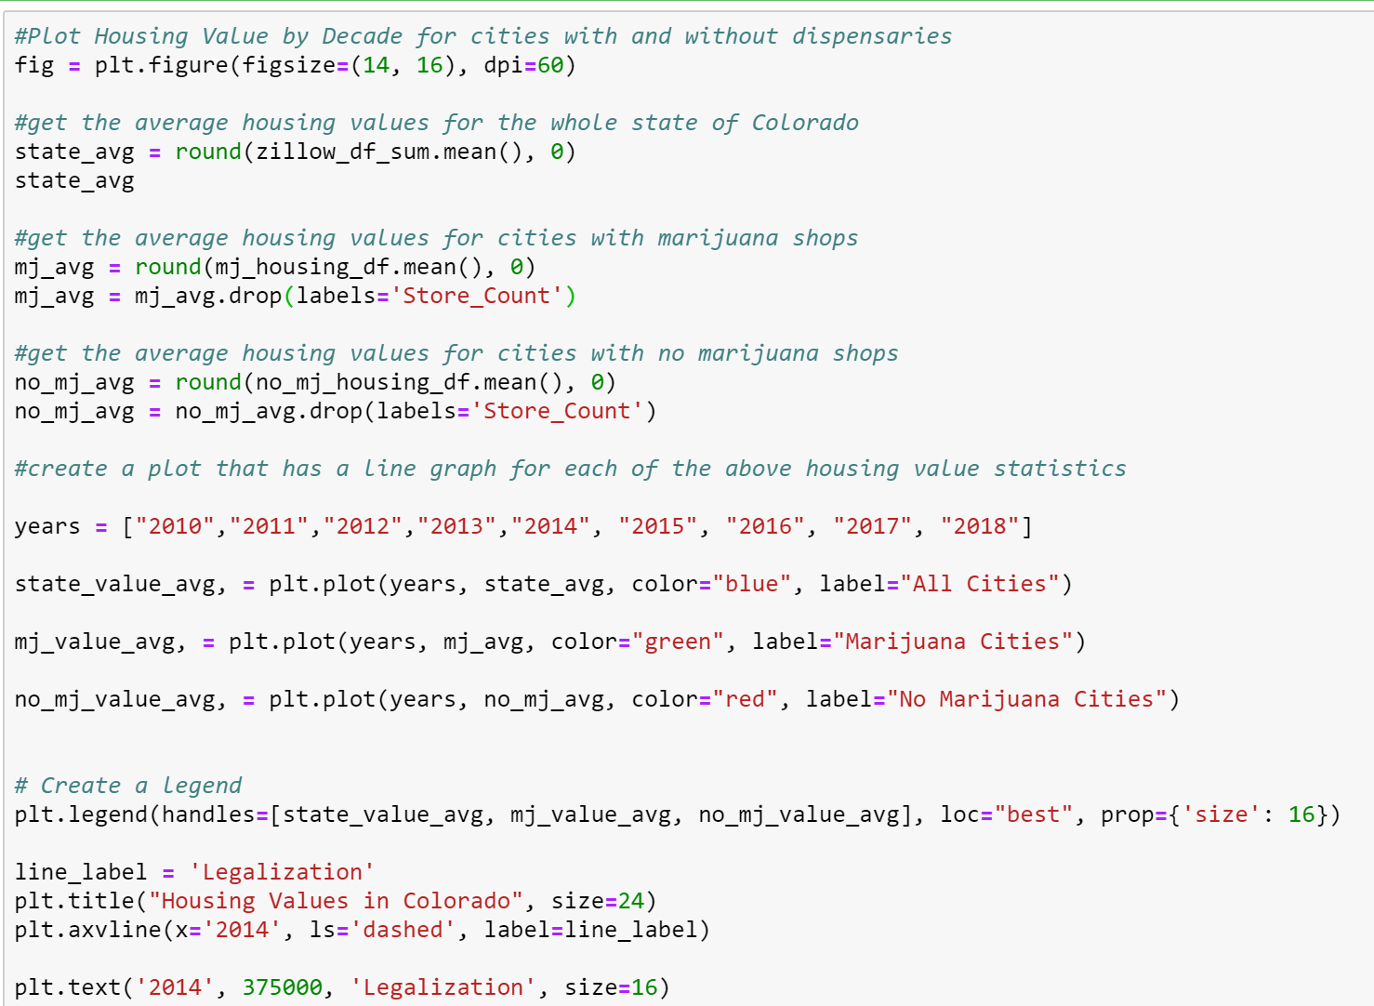

Slide 7
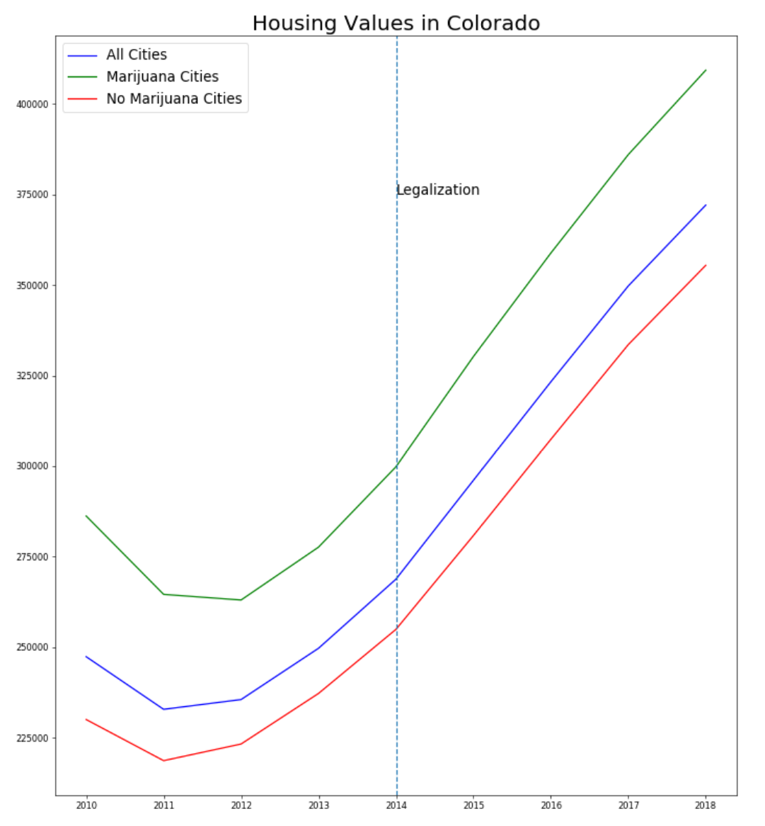
Analysis
Marijuana shops do not appear to affect housing values.
Prices in Colorado were trending up prior to the legalization of recreational marijuana, but after legalization they continued to skyrocket.

Slide 8
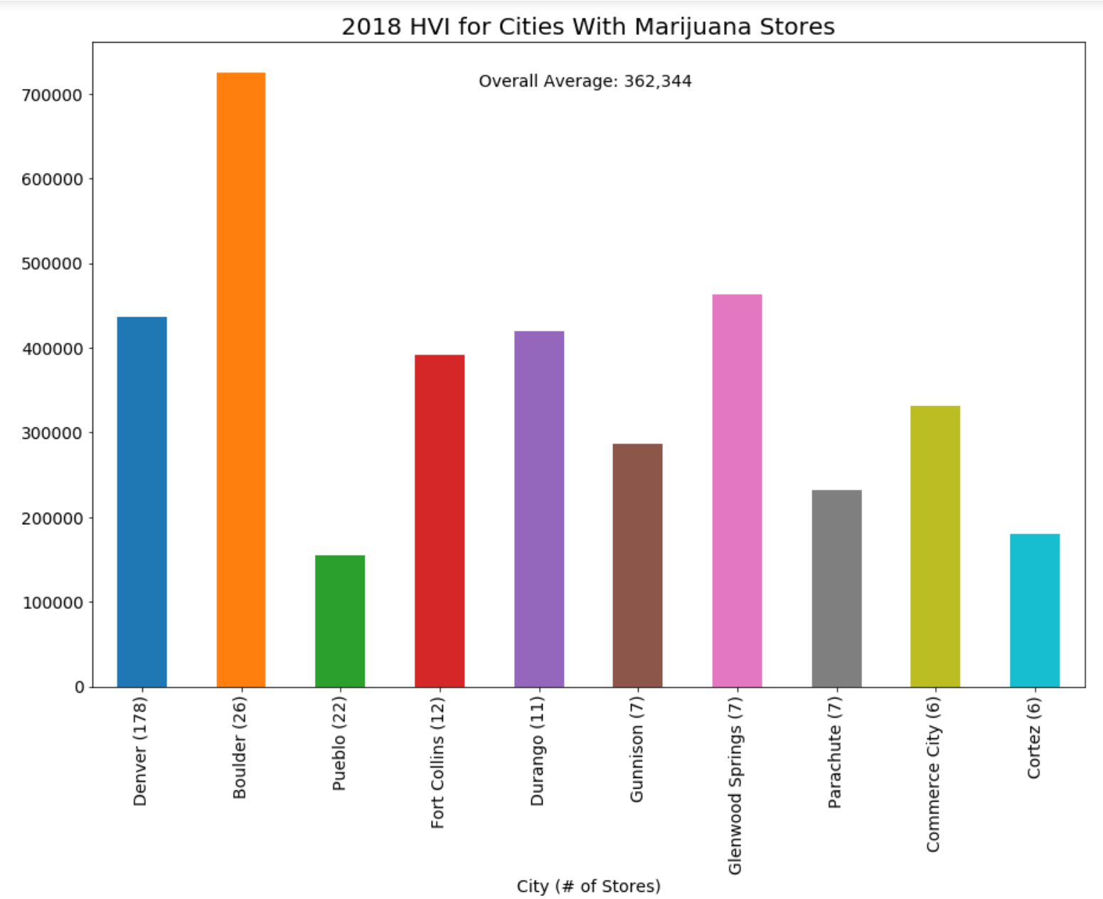
Analysis
Denver, Boulder and Pueblo have the largest number of marijuana shops. (The graph at left shows cities in order of shop #.)
There does not seem to be any correlation between the number of shops and housing prices.
Denver has a population of 719,116 and Boulder has a population of 109,068. This factor does not seem to influence housing prices either.

Slide 9
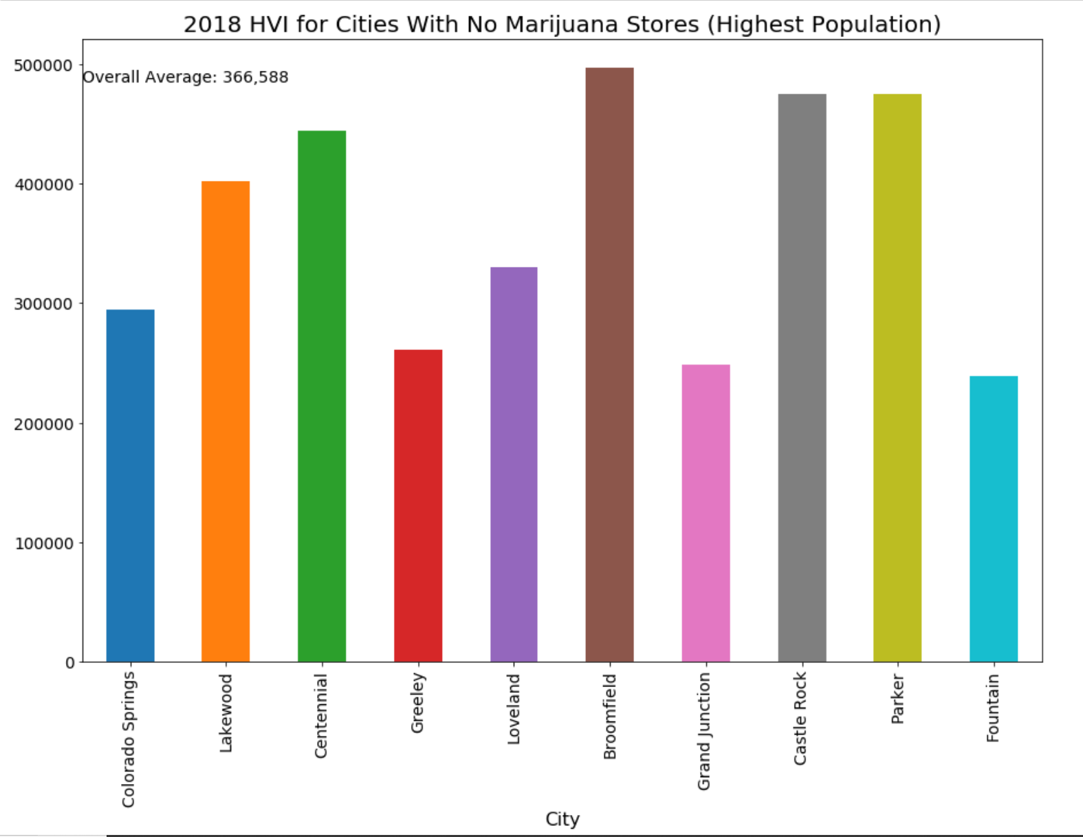
Analysis
For this analysis, we did not have any stores so we used population to decide which cities to include. We wanted to ensure that cities with a very small number of houses were not included as this could skew the housing prices.
The overall average housing price for cities with no marijuana shops is $366,588. This is extremely close to the prior graph (average price was $362,344). We can conclude that marijuana shops do not appear to influence housing prices.
influence housing prices either.

